Slide 1










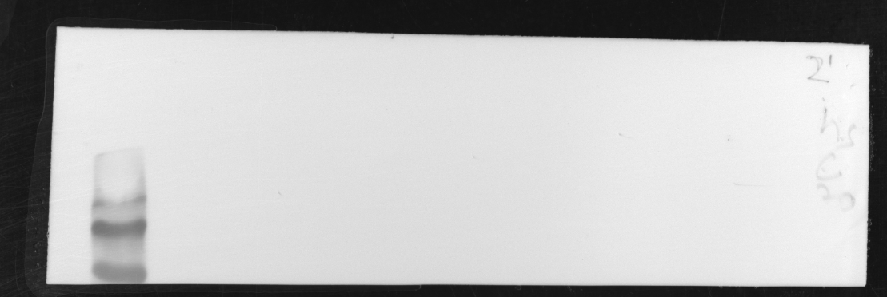

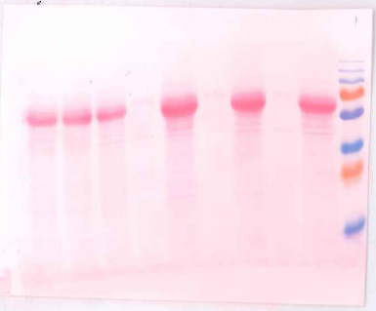
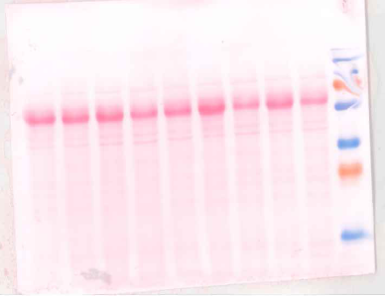
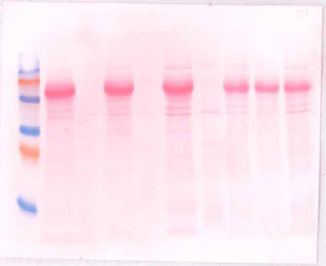
Figure 1D – WB actin/hsc70
1
0
0
1
0
1
0
: μg mCherry actin plasmid
Pan actin
hsc70
Ponceau

Slide 2




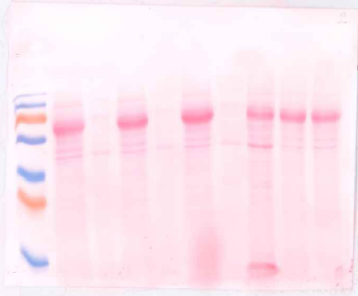
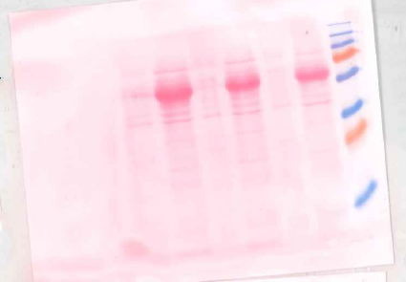
Figure 1E – F/G SiRactin
G F
G F
G F
F G
F G
F G
Pan actin
0
50nM
200nM
200nM
50nM
0
: SiRactin
Ponceau

Slide 3




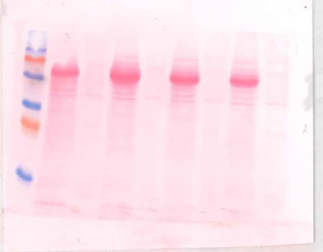
Figure 1E – F/G Actin mCherry
G F
G F
G F
G F
G F
G F
Pan actin
0
1
0
1
1
0
: μg mCherry actin plasmid
Ponceau

Slide 4
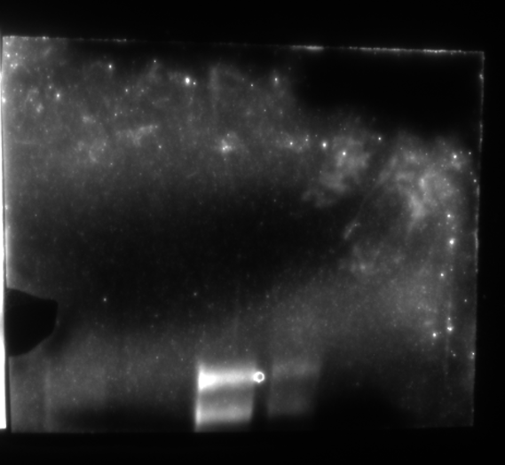

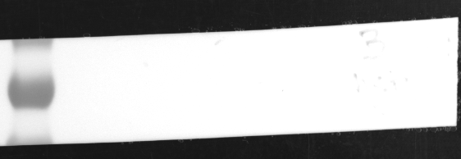
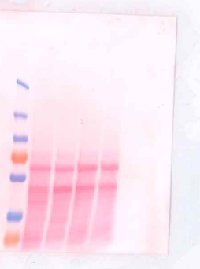
Figure S4A
0
3
1
: μg MRTF-A-GFP plasmid
MRTF-A
hsc70
Ponceau

